Slide 1





044 - 4582 1010
projects@rccplindia.com
www.rccplindia.com

Slide 2




Rayal Consolidated Construction Private Limited (RCCPL) is an engineering and contracts company which is associated with the Rayal Electricals established in the year 2007.
CHENNAI
TIRUPATI
ARIYALUR
WE ARE A GOVERNMENT
LISENCED “SUPER A GRADE”
CONTRACTOR - ENGINEERING
COMPANY

Slide 3


To continue being a highly efficient and trusted construction partner, recognized for our ethical practices, technical excellence, and unwavering commitment to quality. We are dedicated to delivering every project with integrity, transparency, and balance, earning the privilege of being the preferred choice for clients seeking dependable and innovative construction solutions. Through continuous improvement, collaboration, and a customer-centric approach, we strive to set new benchmarks of excellence within the construction industry.
To deliver the highest level of quality construction services to our customers at fair and market-competitive prices. We are committed to maintaining the highest standards of professionalism, integrity, honesty, and fairness in our relationships with clients, suppliers, subcontractors, and employees. By combining innovative practices with skilled craftsmanship, we aim to ensure timely project completion, superior quality, and complete customer satisfaction. Our goal is to build lasting partnerships founded on trust, value, and excellence in every aspect of our work.

Slide 4



Architectural Design
Interior Design & 3d Visualization
MEP & PHE Design
Civil Construction & Interior Work
Electrical Work
Plumbing Work
Data Networking & Communication
HVAC System
Fire Alarm & Fire Hydrant System
CCTV Monitoring & Security System
Annual Maintenance Contract Services
Turnkey Solutions

Slide 5
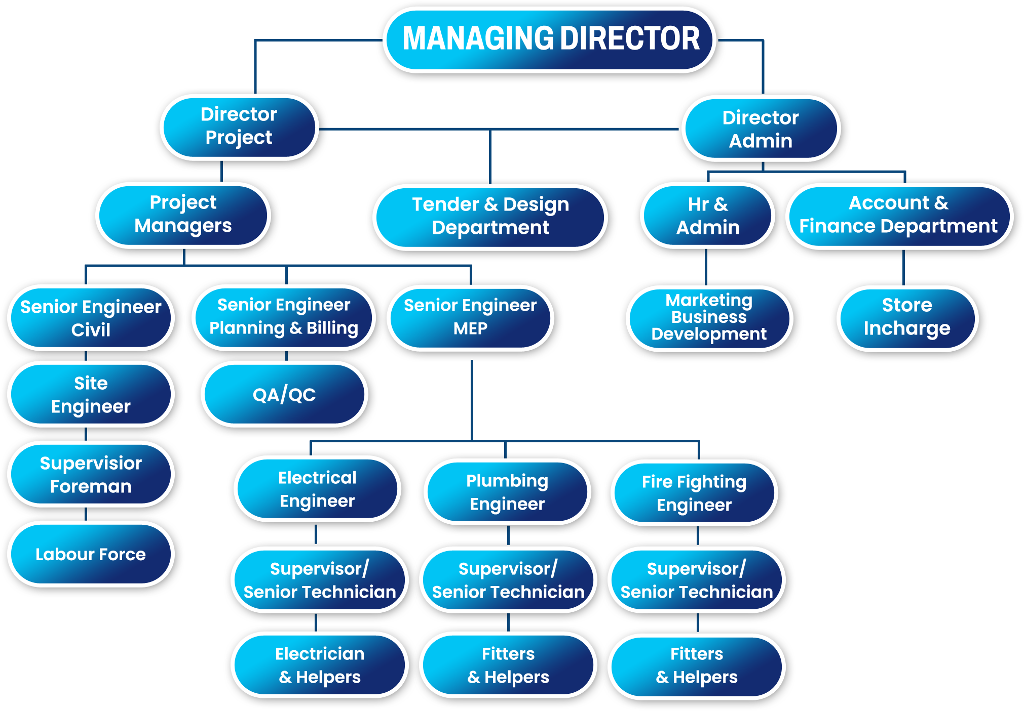

Slide 6






















Slide 7




Homi Bhabha Cancer Hospital, Varanasi, Uttar Pradesh – 1204 Lakhs
TATA Cancer Hospital & Research Centre Assam – 419.27 Lakhs
RK Biotechnologies, Perungudi , Chennai - 212 Lakhs
Theragen Life Sciences Pvt Ltd – 39 Lakhs
SBIOA Global School, Anna Nagar, Chennai – 98.5 Lakhs
Chennai Mathematical Institute, Siruseri – SIPCOT – Chennai - 16 Lakhs
SBIOA Junior College & School , Anna Nagar, Chennai – 7.08 Lakhs
Sri Dharsiniee Enterprises - Balaji Dental College – 6.12 Lakhs

Slide 8


Royal Nesto Villas - Coimbatore - 547 Lakhs
Maali & Manvi Homes - Virugambakkam - 221.63 Lakhs
Kannadhasan Residential Building - Ramapuram - 110 Lakhs
Mr. O. G. Muralikrishnan - Residential Project - Chennai - 86.51 Lakhs
Mr. Sampath General Manager - NLC, Porur, Chennai - 86 Lakhs
Mr. A.K.Vijayan - Villas, Perambur, Chennai - 80 Lakhs
Dasa Infra Systems Pvt Ltd – 160 Lakhs
Atria Power (Under Dasa Infra System Pvt Ltd)
120MW(60MW*2)220kv/33KV Pss-bageiwade, Karnataka – 100 Lakhs
Rays Power Infra Pvt Ltd (Under Dasa Infra System Pvt Ltd) 100mw
110KV/33KV Pss - Pasuvanthanai, Thoothukudi – 40 Lakhs

Slide 9


Kalyan Grand Stay Pvt Ltd -3 Star Hotel Project, Vandalur – 299 Lakhs
CK’s Food Limited – Coimbatore & Chennai 130 Lakhs
Jubilant Food Works (DOMINO’S PIZZA) – 43 Lakhs
Hotel Thiruvasantham – Chennai – 37 Lakhs
ACCENTURE - Tamil Nadu & Kerela - 400 Lakhs
ZEBRONICS OFFICE (Dr. Arumugam - Commercial Complex) - Ph Road, Egmore,
Chennai - 265 Lakhs
Tech Mahindra Limited - Fire Hydrant - Sholinganalur - 145 Lakhs
SHELL - Pallikaranai - Chennai - 80 Lakhs
Tech Mahindra Limited - Chennai (Swimming Pool & Pumproom Work) - 39.48 Lakhs

Slide 10

PACHAIYAPPA SILKS (Dr. Andal Arumugam – Shopping Complex),
T.Nagar, Chennai- 280 Lakhs
Pioneer Protein Point , Pammal, Chennai – 67 Lakhs
Pioneer Protein Point , Madambakkam, Chennai – 57.3 Lakhs
Pioneer Protein Point & Restaurant, GG Nagar, Chennai - 56 Lakhs
Pioneer Protein Point , Kundrathur , Chennai – 52 Lakhs
Pioneer Protein Point , Alapakkam, Chennai – 48.4 Lakhs
Pioneer Protein Point , Iyyapanthangal Chennai – 43 Lakhs
Realty Holding LLP – Nungambakkam – 19 Lakhs

Slide 11

Indian Port Association - Chennai Port Trust - Network Project
(Under Tech Mahindra Limited) - 152 Lakhs
Indian Port Association - Chennai Port Trust - Infra Project
(Under Tech Mahindra Limited) - 114 Lakhs
Government Model Highger Secondary School
– Perambalur – 15 Lakhs

Slide 12

Flextronics – Sriperumbathur, Chennai – 218 Lakhs
KAR REALITY HOLDING LLP- CHENGALPATTU – 204 LAKHS
RK SHIRTS PRIVATE LIMITED – PATNA – BIHAR – 86.7 Lakhs
Pina Abrasives India Pvt Ltd (Eura-D&A) – Sricity , Thada, Ap - 70 Lakhs
Ampenol Mobile Communication Products India Limited - Sricity Sez,
Thada, Ap - 65 Lakhs
Southern Group Of Industries - Alwarpet, Chennai- 60 Lakhs
Mas Linea Leather Accessories Pvt Limited, Mepz, Chennai – 55 Lakhs
EMCEE Fabrictech & Pressing Pvt Ltd – Irungattukottai – 28 Lakhs

Slide 13

JIPMER Hospital - Karaikal - 2600 Lakhs
Railway Station Revamping Work - Rameshwaram - 1230 Lakhs
Infra Development Work For SBIOA Campus
Sonalur, Chennai - 513 Lakhs
SBIOA International School Project - 350 Lakhs
SBIOA Arts & Science College - 251 Lakhs
The Sea - La Palmera Beach Resort (K4 Groups)
- ECR - Sayalkudi - Ramanathapuram - 186.3 Lakhs
SBIOA MBA College Project - 119 Lakhs
Mr. Kothandamoorthi - Residency - Kolathur - 105 Lakhs

Slide 14
Mr. Deepak Agarwal - Beach Bungalow (ECR) - 96 Lakhs
M/S Tech Mahindra Limited - Chennai - 94 Lakhs
Accenture Solutions Pvt Ltd - 52.9 Lakhs
RK Industries IV Head Office - Guindy - 30 Lakhs
BLM Group’s Office - Chennai - 18 Lakhs

Slide 15

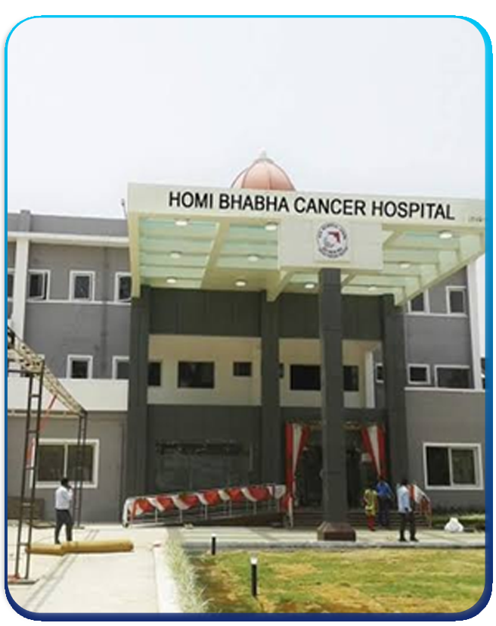
33KV SUBSTATION
2020 KVA DG YARD
LT ELECTRICAL WORK
UPS
DATA NETWORKING
TELECOMMUNICATION
CCTV MONITORING SYSTEM
PROJECT VALUE Rs.12 Cr

Slide 16

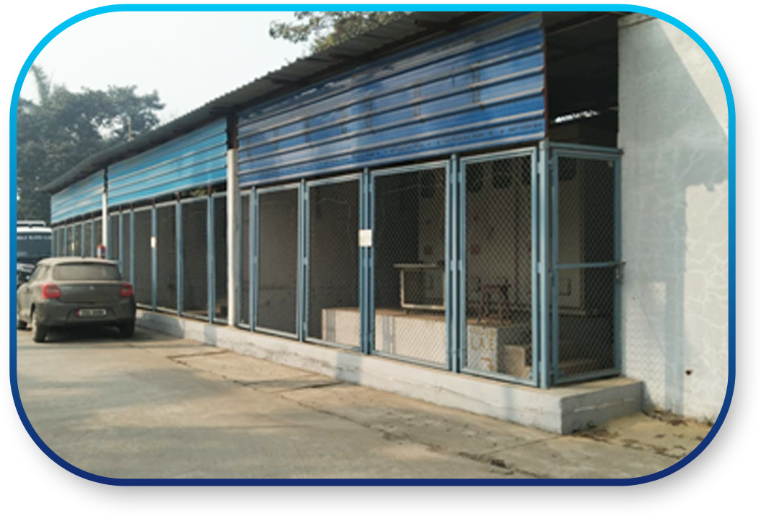
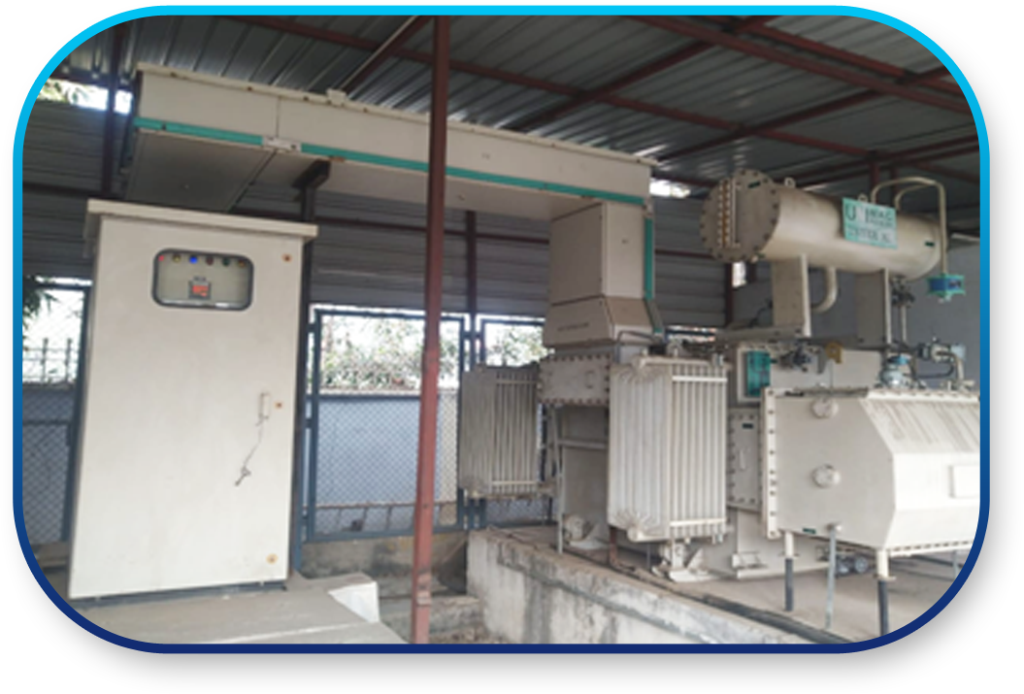
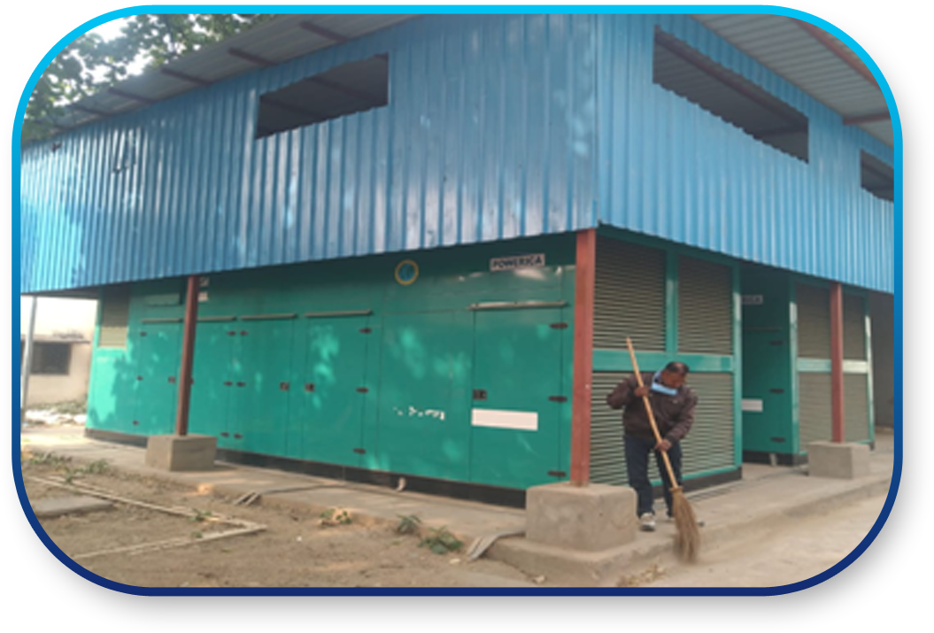
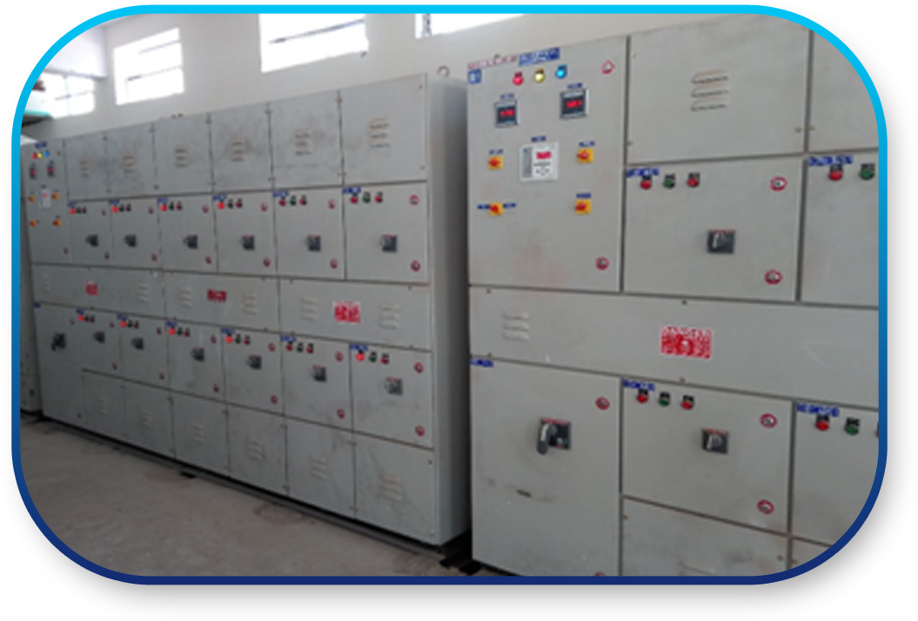

Slide 17

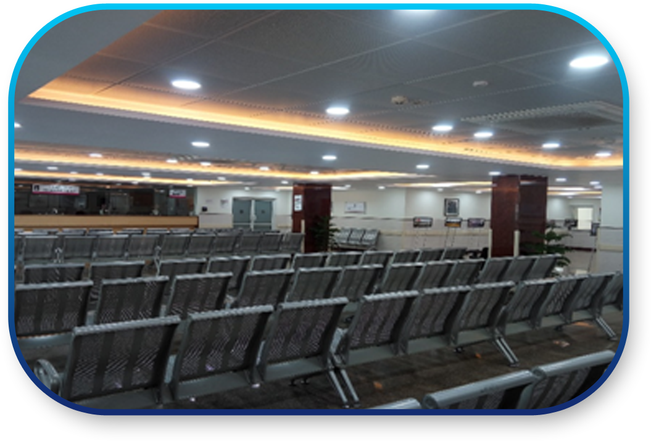
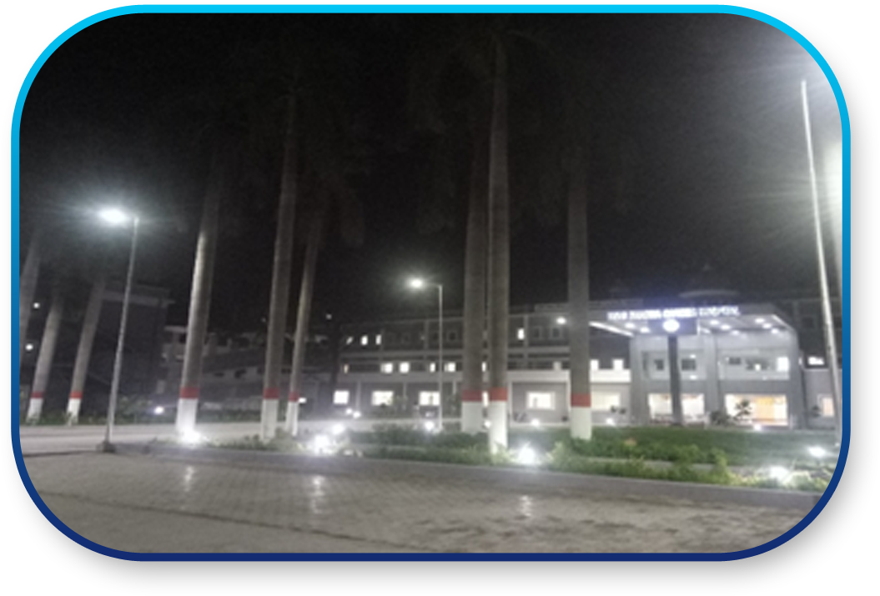
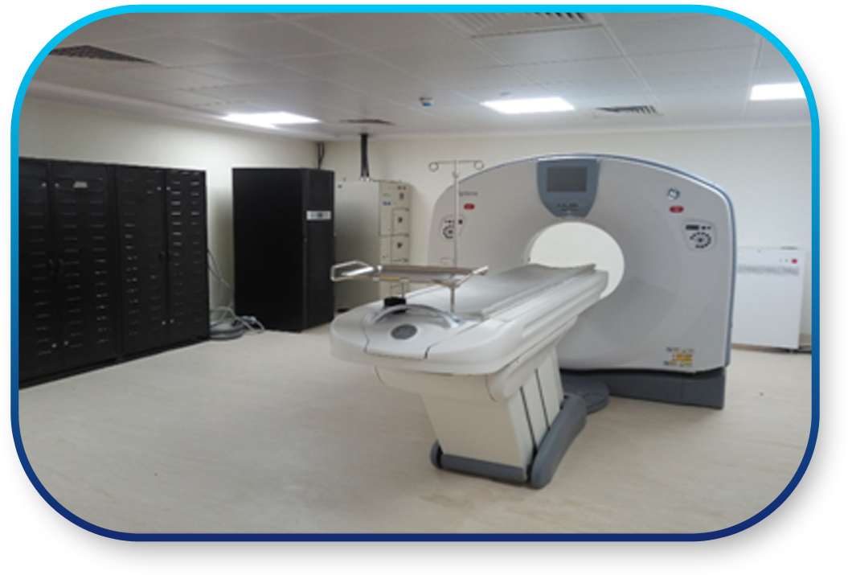
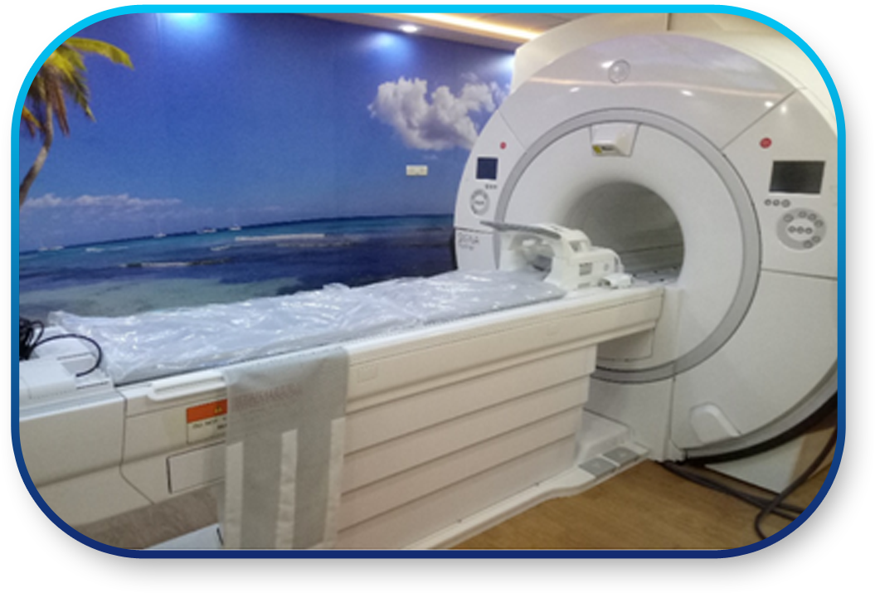

Slide 18

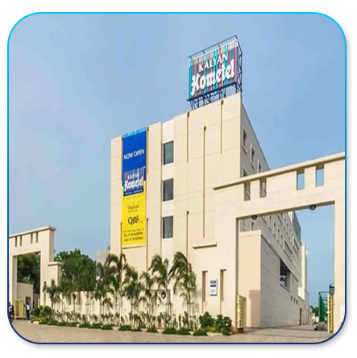
11 KV SUBSTATION
LT ELECTRICAL WORK
DATA NETWORKING
TELECOMMUNICATION
CCTV MONITORING SYSTEM
PROJECT VALUE Rs. 3 Cr

Slide 19
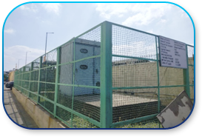
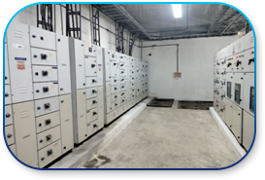
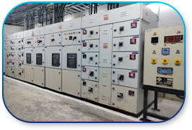
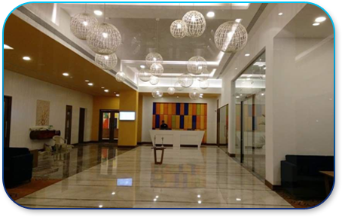
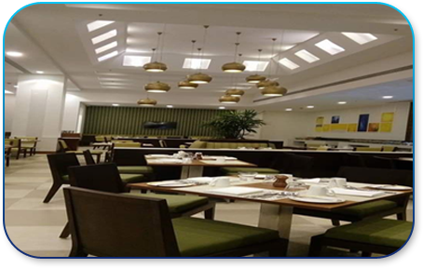

Slide 20

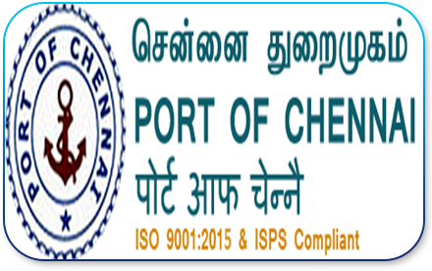
CIVIL & INTERIOR WORK
FURNITURE
ELECTRICAL WORK
NETWORK INFRA WORK
ACCESS CONTROL & CCTV MONITORING SYSTEM
FIRE ALARM & GAS FLOODING SYSTEM
AC SYSTEM
PROJECT VALUE Rs.2.7 Cr

Slide 21

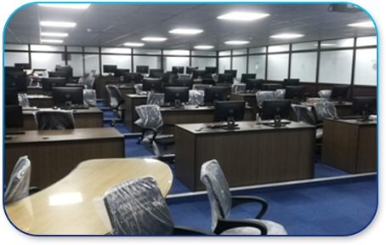
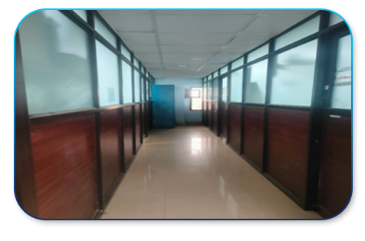
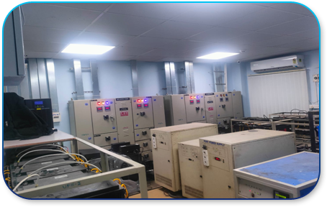
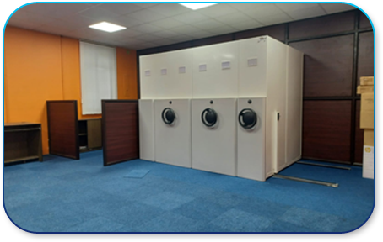

Slide 22

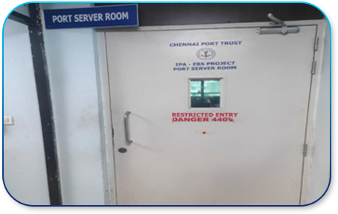
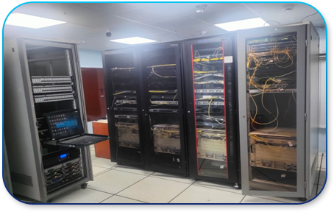
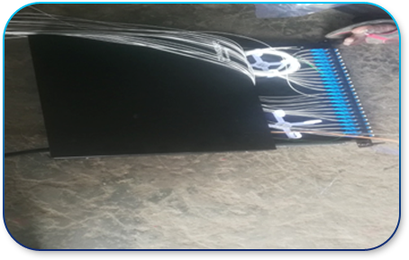
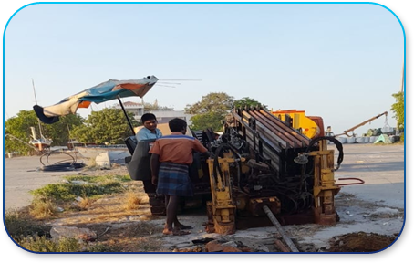

Slide 23


CIVIL & INTERIOR WORK
CLEAN ROOM & LAB CABIN
ELECTRICAL WORK
PLUMBING WORK
NETWORK COMMUNICATION SYSTEM
ACCESS CONTROL & CCTV MONITORING SYSTEM
FIRE ALARM & FIRE HYDRANT SYSTEM
HVAC SYSTEM
PROJECT VALUE Rs.3.65 Cr

Slide 24
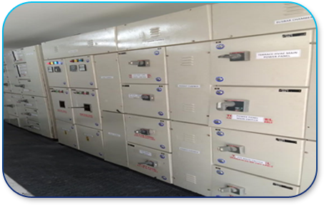
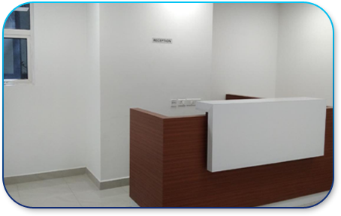
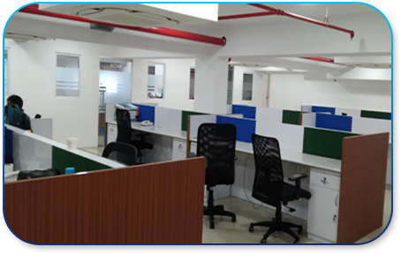
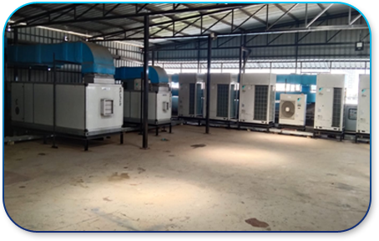

Slide 25

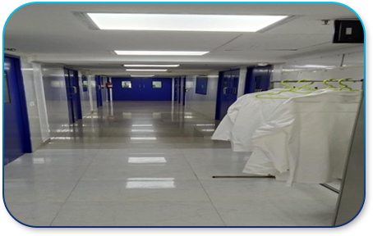
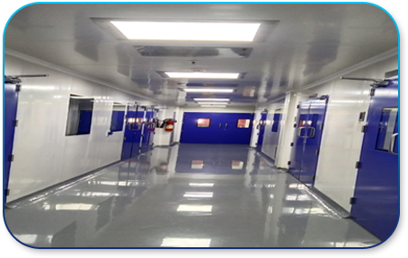
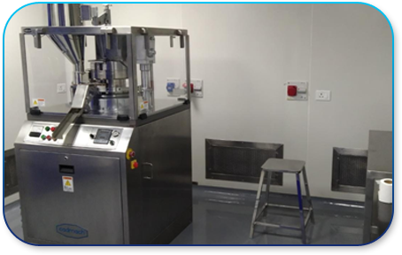
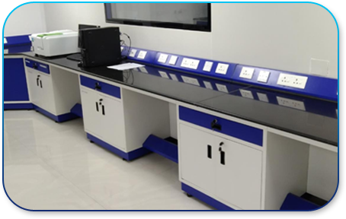

Slide 26

CIVIL & INTERIOR WORK
ROAD INFRA
ELECTRICAL WORK
PLUMBING WORK
FIRE HYDRANT SYSTEM
ELECTRICAL AMC
PAINTING RATE CONTRACT
PROJECT VALUE Rs.1.85 Cr

Slide 27
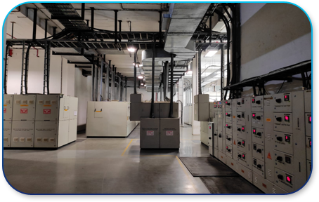
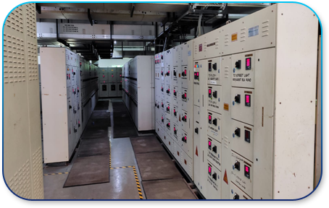
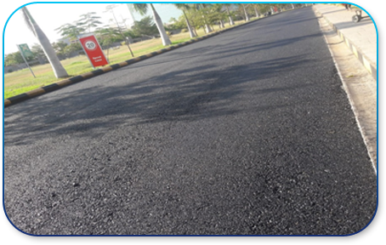
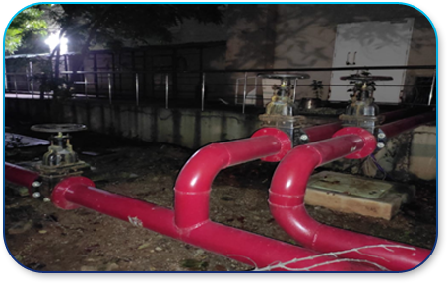

Slide 28

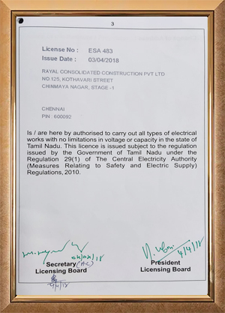
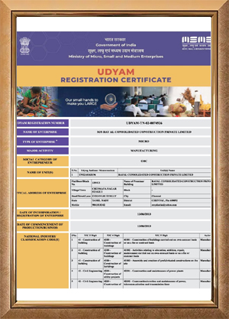
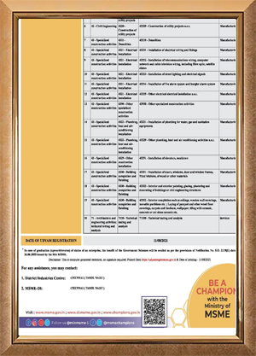

Slide 29






No.120/20, 3rd Floor, Natesan Nagar 3rd Main Road,
Virugambakkam, Chennai – 600 092.
projects@rccplindia.com
admin@rccplindia.com
rccplindia@yahoo.com
044 – 4582 1010 & 044 - 4352 2228
9841818342 / 9940087501
8525949393 / 9176843111

Slide 30



